Slide 1
Final Presentation
MHCPMS TEAM RED

Slide 2
Content
features implemented vs. design thinking ideas
architecture & coding highlights
list of personal contribution for each team member
lessons learnt
demo

Slide 3


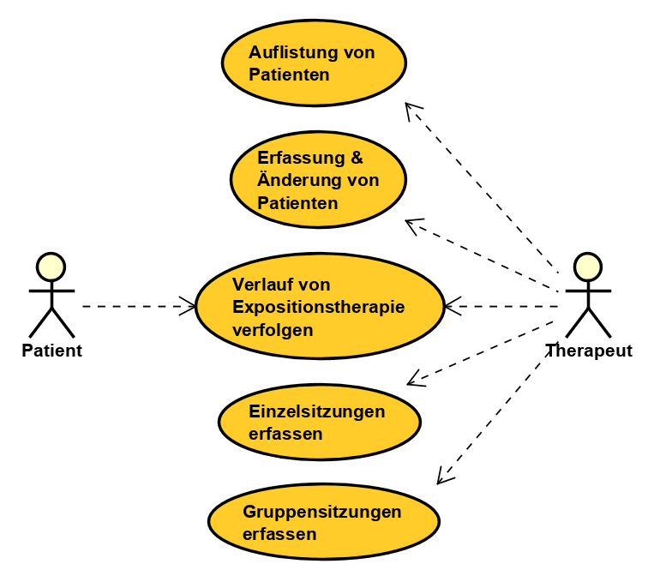



features implemented vs. design thinking ideas

Slide 4
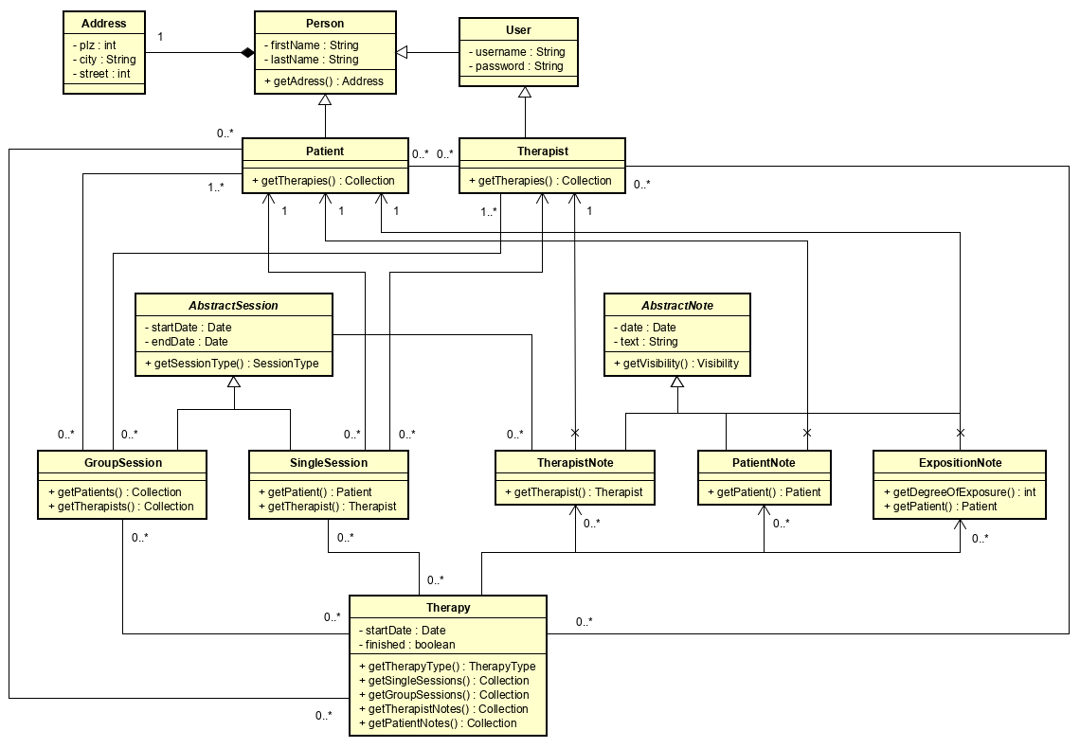
Architecture

Slide 5
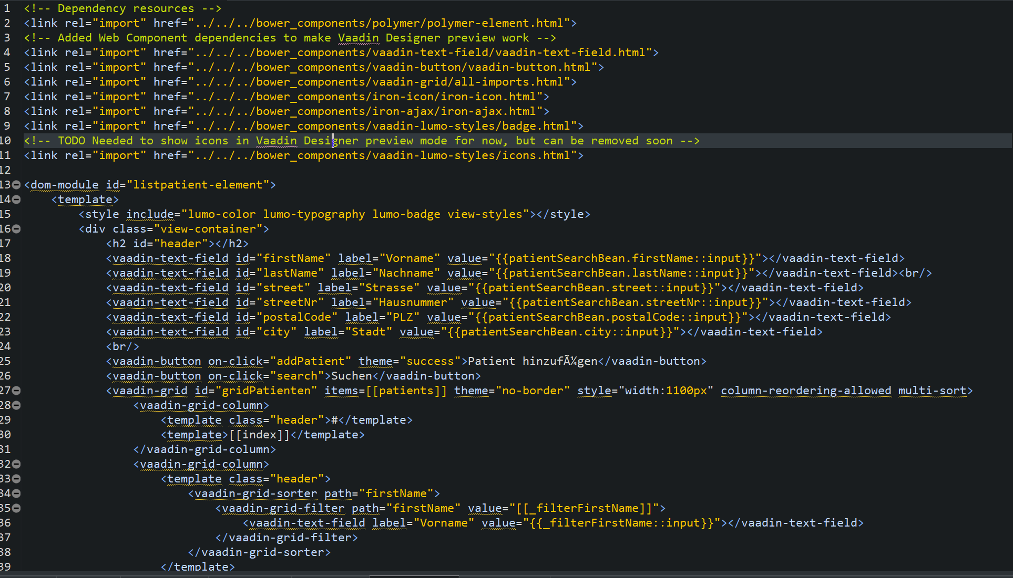
Coding Highlights: Polymer Template

Slide 6
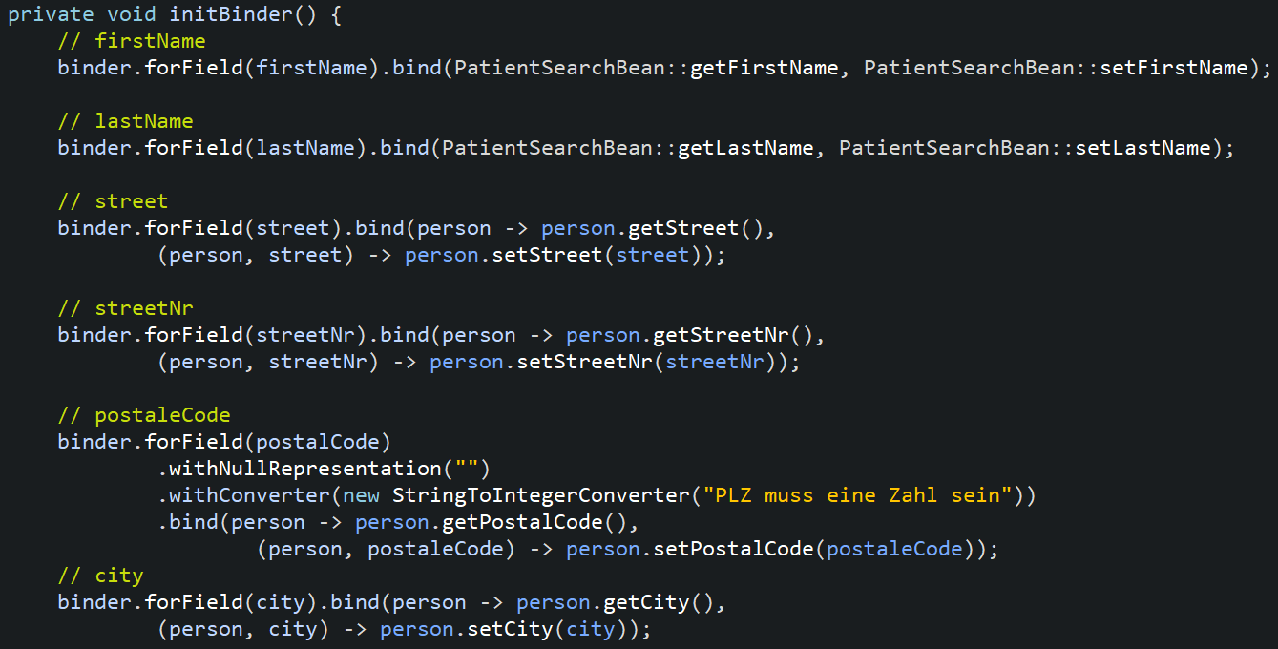
Coding Highlights: Polymer Template

Slide 7
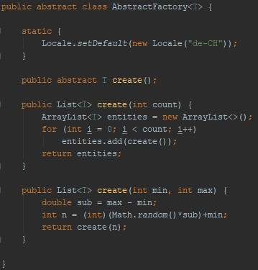
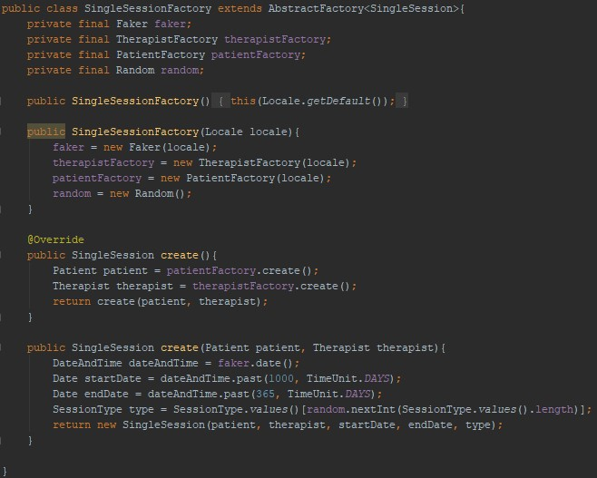
Coding Highlights: Factories

Slide 8
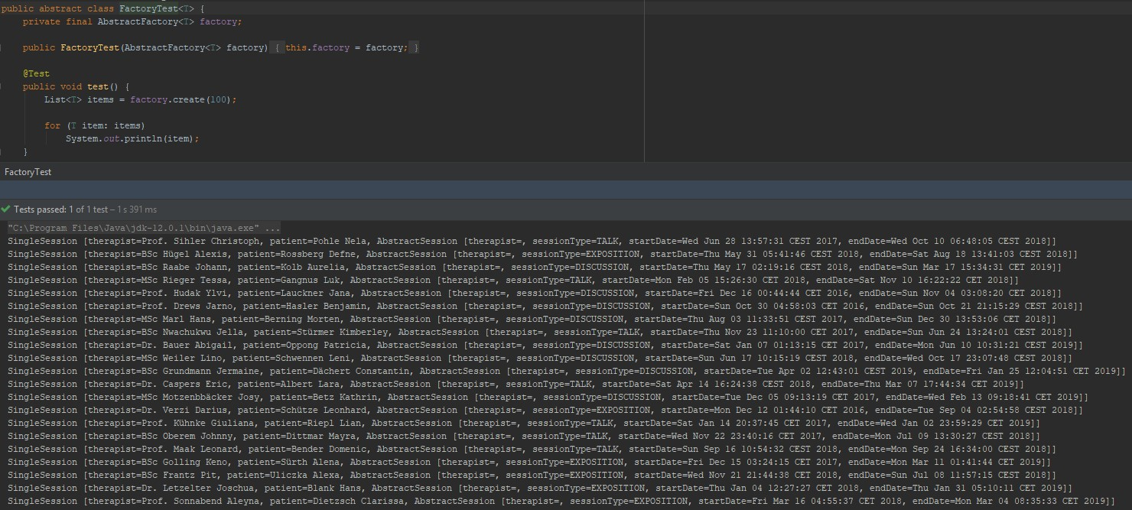

Coding Highlights: Factories

Slide 9
List of personal contribution
Member | Contribution
Ueli Kramer | Therapies, Scrum Master
Cyrill Meyer | Patients, Scrum Master
Marc Hutzli | Single & Group Sessions
Sophie Haug | Exposition therapy
Steve Blaser | DB, Repositories, Services
Sascha Schwärzler | Models, Unit testing

Slide 10
Lessons learnt
Scrum is hard when not everybody works full time on a project
If you can’t finish your task in time don’t start a new one
Spring does many things for you, but sometimes it’s difficult to understand what
People need to accept others approaches

Slide 11
DEMO

